Slide 1
Individual project details
ML and Mechanistic modeling tracks

Slide 2
Model types, merits and drawbacks
DATA DRIVEN MACHINE LEARNING MODELS
Computational inference can pick up patterns in high-dimensional data that humans will never be able to recognize
Based on data and numbers alone, ignorant of biological & physical realities
Fast, cheap and accurate
‘Black box’ models can be difficult to interpret
The modeler must draw on their understanding of reality and the data to determine whether the model is valid
Static & deterministic
LITERATURE BASED MECHANISTIC MODELS
Rooted in the decades of experimental & philosophical understanding of biological systems
Difficult to parameterize, small variations in inputs can propagate to large errors in outputs
More computationally expensive, but accurate when you don’t have enough data to build an ML model
Easier to interpret and understand
The modeler must account for lack of knowledge within the system - patterns they don’t see
Dynamic & probabilistic
Notes:
Not competing options but complementary

Slide 3
Project tracks
DATA DRIVEN MACHINE LEARNING MODELS
Literature & database search for data
Data analysis and curation
Model building & HPO using Python
Model analysis - uncertainty & limitations w/ Python
Using models for inference w/ Python
LITERATURE BASED MECHANISTIC MODELS
Literature & database search for pathways & parameters
Curation and formulation of necessary components of model
Model building and refinement using RuleBender
Model analysis - uncertainty & limitations w/ RB + Python
Use model simulations for inference w/ RB + Python

Slide 4
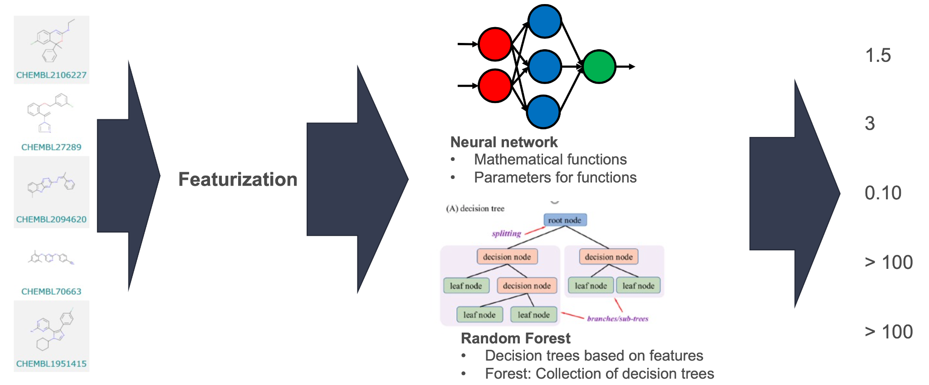
Data driven ML models

Slide 5
Data driven ML model questions
What is your target? How does it relate to cancer, blood brain barrier and DNA damage response? What kind of experiments are run to acquire the data?
What are the compounds in your dataset? Are they structurally diverse or form a series? How much of chemical space do they take up? What might be missing from the dataset?
What are the values in your target output? Do they span a wide range? Do structurally similar compounds have different values or similar values? Do you have a lot of actives or is the data imbalanced? Are there a lot of censored values?
What is your best model? Do you have enough data to create a good regression model or need to do classification only? Did you cover all the bases in your hyperparameter search or need to extend it?
What can you learn from your model? To what extent is it generalizable to brand new compounds? Are there regions of uncertainty in chemical space? What compounds would you send for validation experiments to get more data?

Slide 6
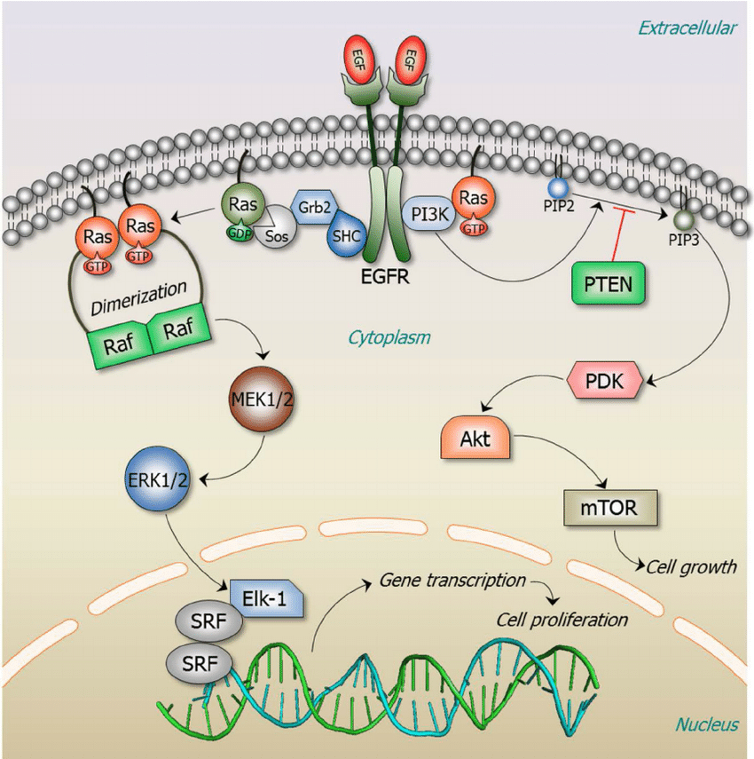
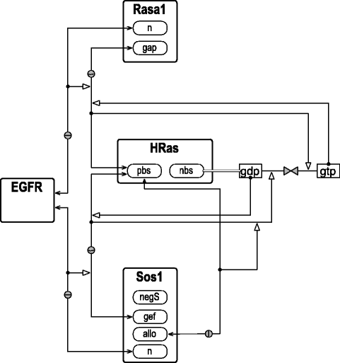
Literature-based mechanistic models
Rules:
Protein-protein interactions
Conformational changes
Compartmentalization
Feedback loops
Post-translational modifications & residue locations
Parameters:
Concentration
Diffusion & transport
Enzyme / reaction kinetics
Equilibrium & rate constants

Slide 7
Literature-based mechanistic model questions
What is your target pathway? How does it fit in with cancer, BBB and DDR?
What components of the pathway are most important to include in the model? How are all the components linked together? What protein-protein interactions occur within the model, and what other pathways might be linked to it through feedback loops?
What data do you need to parameterize the model? How accurate is the data in the literature? How can you extrapolate from animal to human parameters? What mathematical equations govern the kinetics and interactions between components?
How does your model behave? Can you accurately simulate known chemical modulators of the pathway to predict proper outcomes? What are the edge cases you might need to consider?

Slide 8





ATOM Platform
Property Prediction Pipeline
Efficacy
Prediction & Design Loop
Multi-level models
Systems models
Safety
Working
Compound
Library
PK
Design Criteria
Developability
Generative Molecular Design
proposes new molecules with optimized properties
Active learning decides if/when a simulation or experiment is needed to improve or validate models
Retrain property prediction models
Molecular Feature
Simulations
Simulation
Human-relevant assays, complex in vitro models
Chemistry Design & Synthesis
Experiment

Slide 9
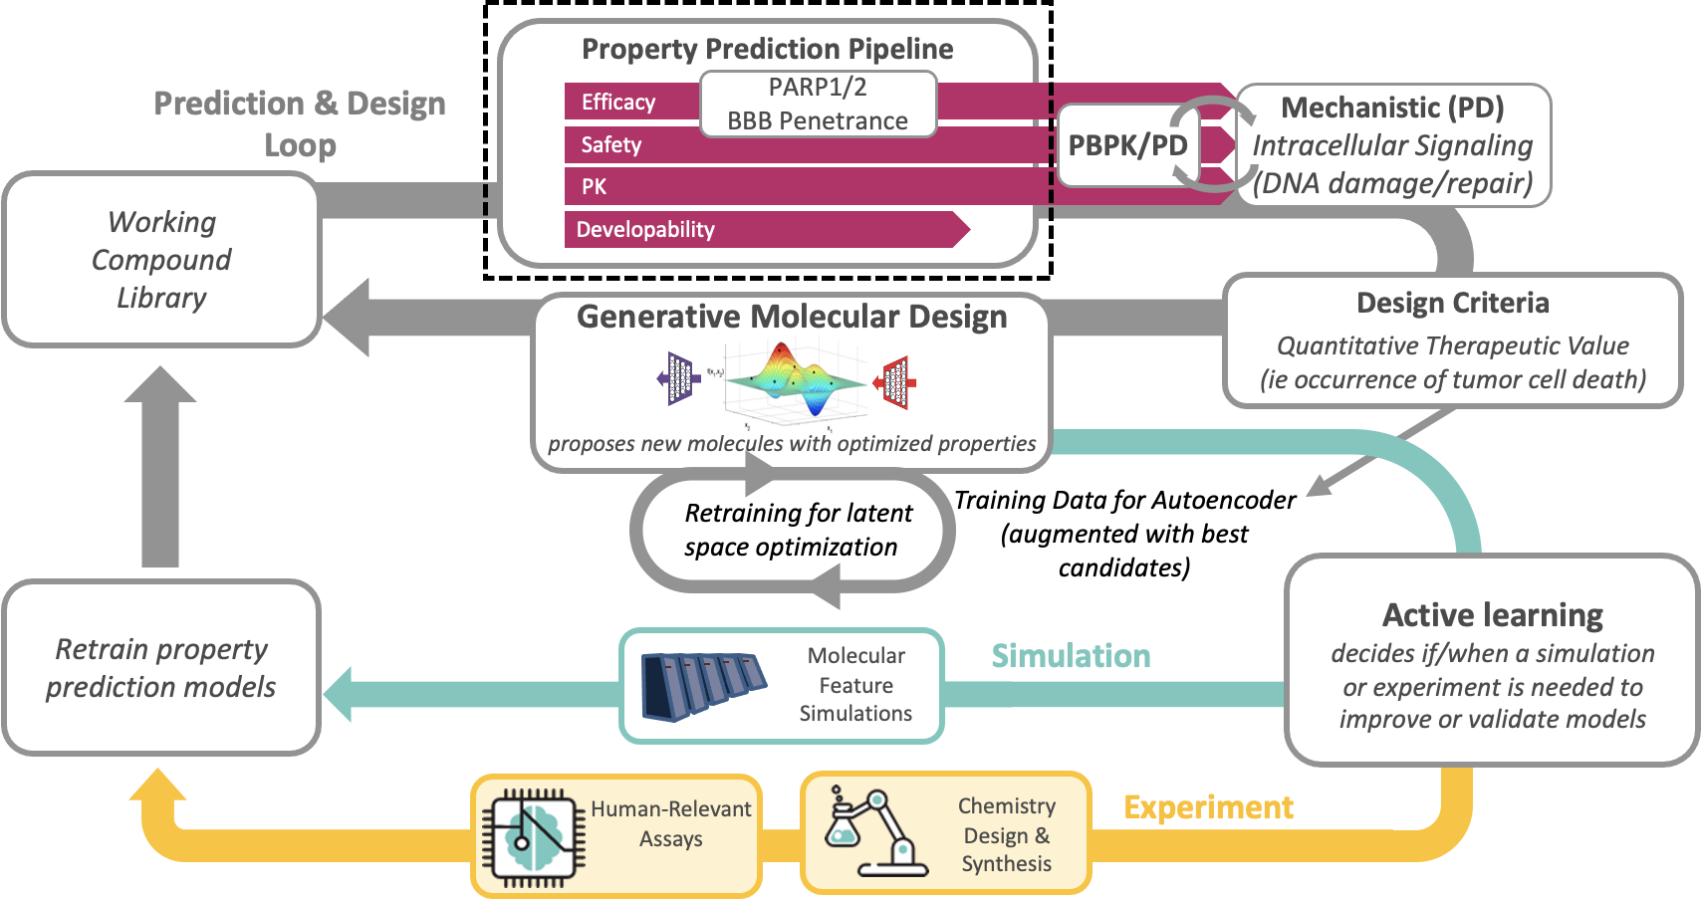
Future ATOM Platform - LSO+PD

Slide 10
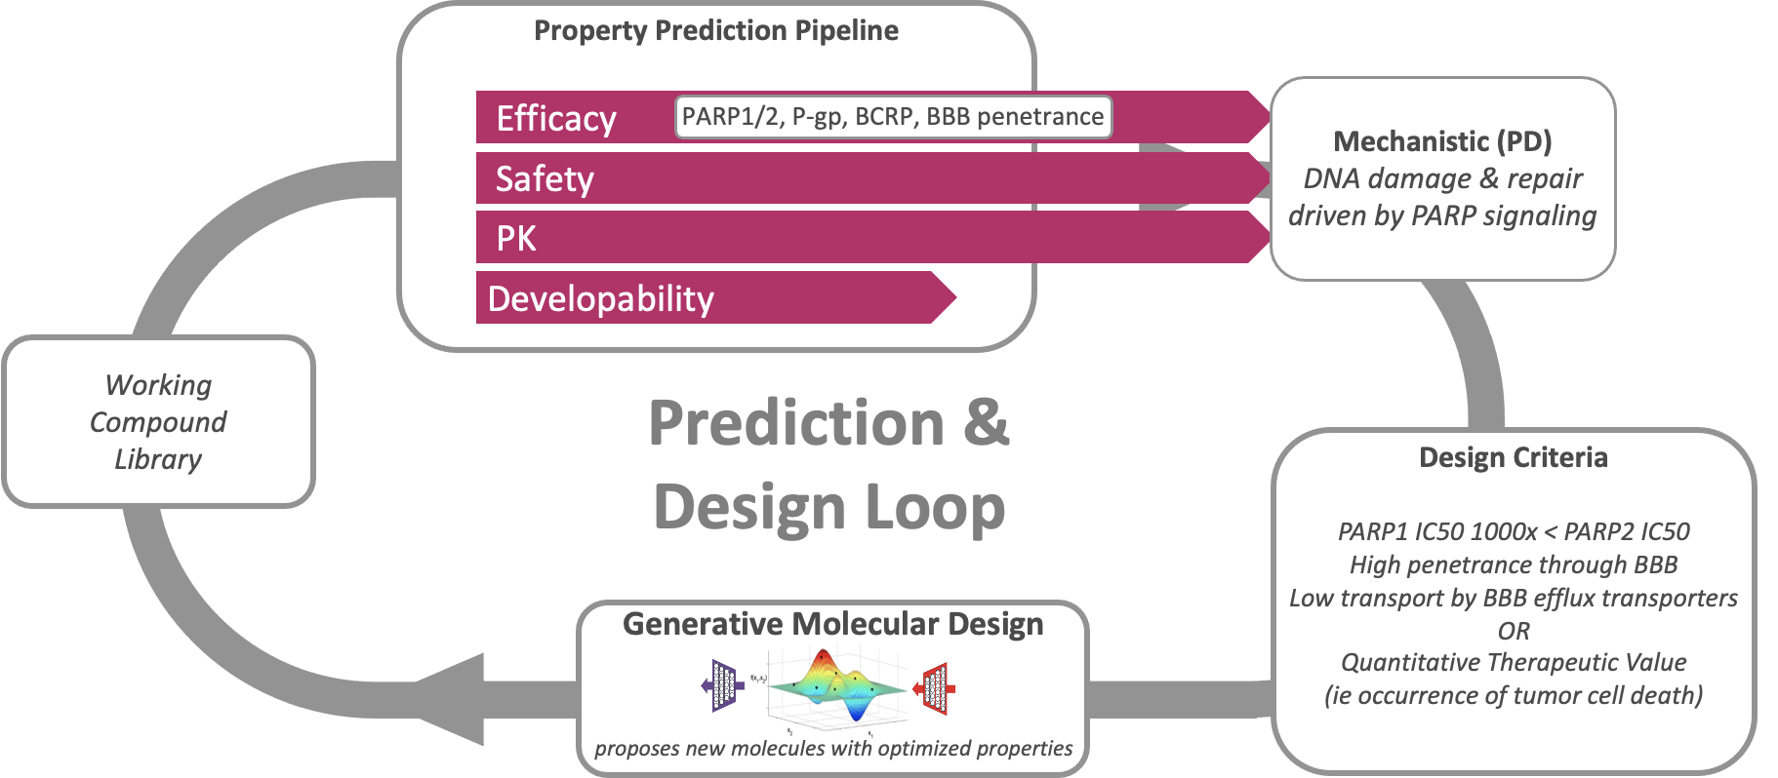
Linking your projects with the ATOM platform

Slide 11
Project sign-ups
DATA DRIVEN MACHINE LEARNING MODELS
PARP1 ( therapeutic target)
Ryan
P-gp (BBB efflux transporter)
Sarah
BCRP (BBB efflux transporter)
BCRP
Passive BBB penetration
Caiden
LITERATURE BASED MECHANISTIC MODELS
Compartmental Modeling of Components of the DDR that Regulate PARP1 Activity
Natalia
Impact of Clinical Therapeutics on PARP1/2/3 Family Members and their Downstream Substrates
Zahra

Slide 12
Journal club signups
Week 1: 6/3, send paper to Susan by 5/31
Caiden, Ryan
Week 2: 6/10, send paper to Susan by 6/7
Natalia, Kendra
Week 3: 6/17, send paper to Susan by 6/14
Sarah, Zahra

